Slide 1

Dissertation Viva MSc Data Science
Project Title: Brain Tumor Binary Classification from MRI images using Convolutional Neural Network and VGG16 with transfer learning
Student Name: Altoglou Athanasios
Student ID: 219082215
Date: 05-September-2022

Slide 2
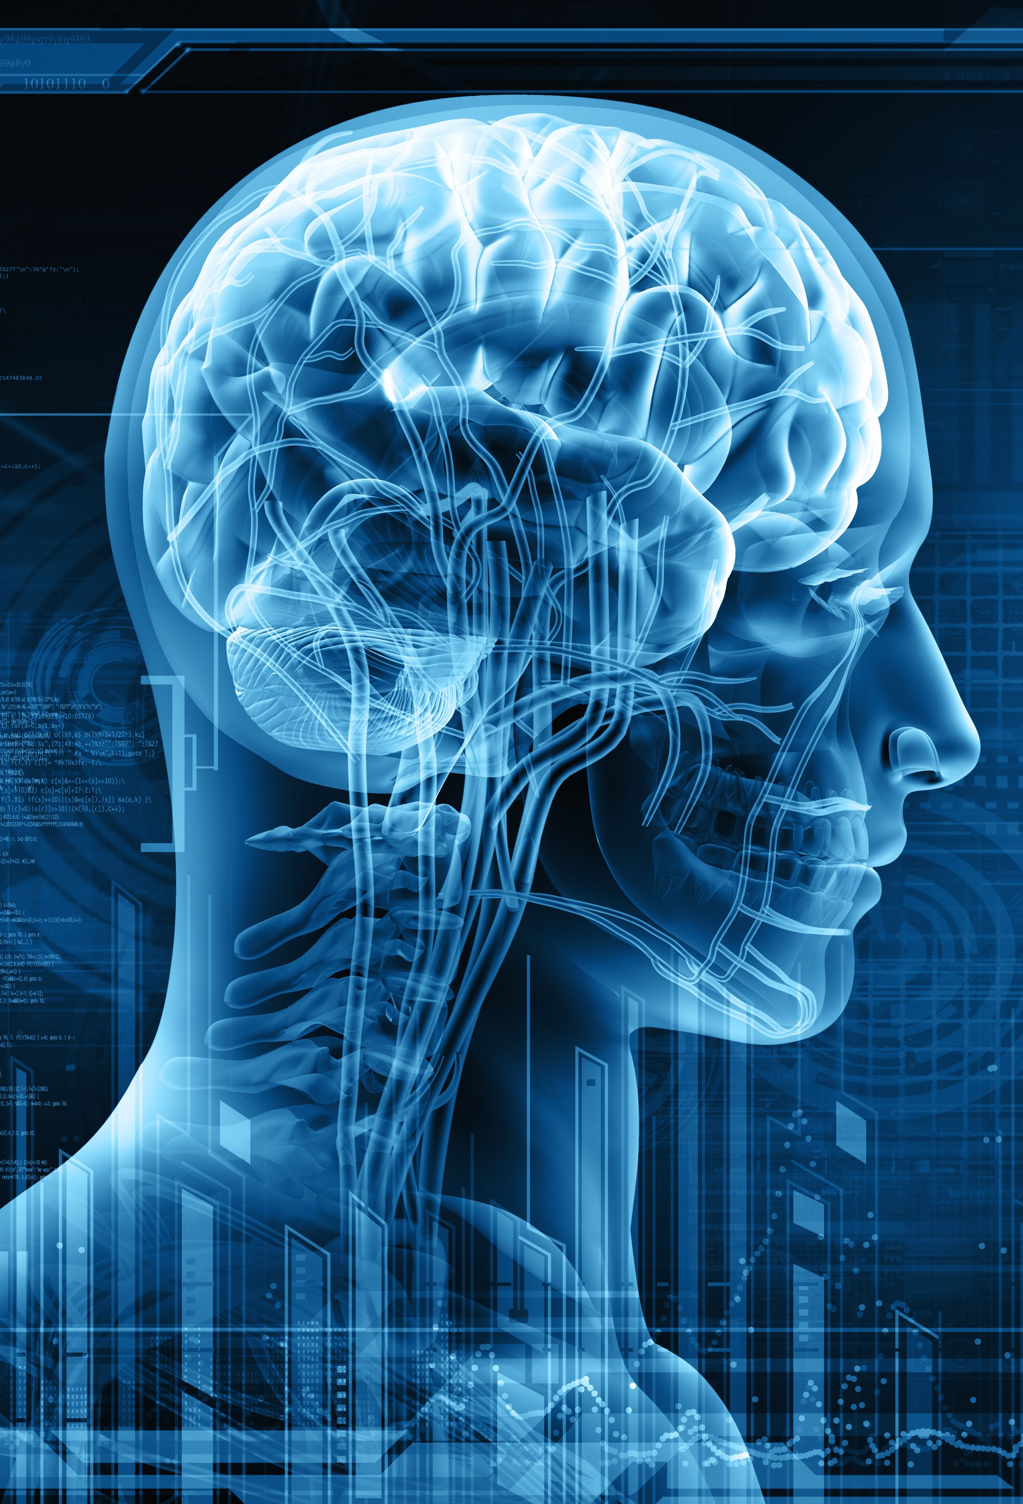
Introduction
Brain tumor is the abnormal mass in the cells form within the brain.
Brain tumors can be benign (healthy) or malignant (cancerous) depending on how they spread to other parts of the brain.
Early detection of brain tumor is vital for patients which is often made by Magnetic Resonance Imaging (MRI) (Kang et al., 2021).

Slide 3
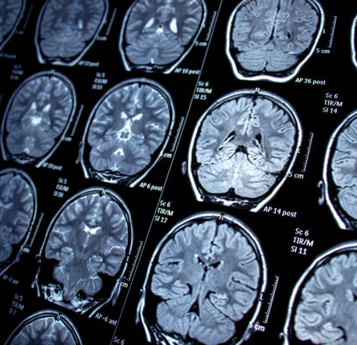
Problem Description
Appropriate planning and accurate brain tumor detection plays a crucial role in clinical diagnosis for patients’ treatment (Swati et al., 2019).
Applying classical machine learning methods is a very challenging task for a non-expert because:
It is time consuming
Requires prior sufficient knowledge
Relies on several pre-processing steps
Deep learning and computer vision applications have seen huge advancements in the field of medicine and Convolutional Neural Networks can be used effectively to diagnose tumor in brain MRI images (Irmak, 2021).

Slide 4

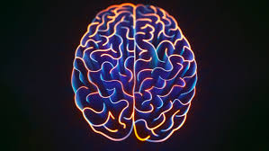
Aims
The aims of this project are to:
Accurately detect brain tumor from MRI images using 2 approaches:
Build a Convolutional Neural Network from the scratch.
Use a pre-trained model called VGG16 with transfer learning.
Develop a web app that can predict whether a given brain image is affected by tumor or not.

Slide 5
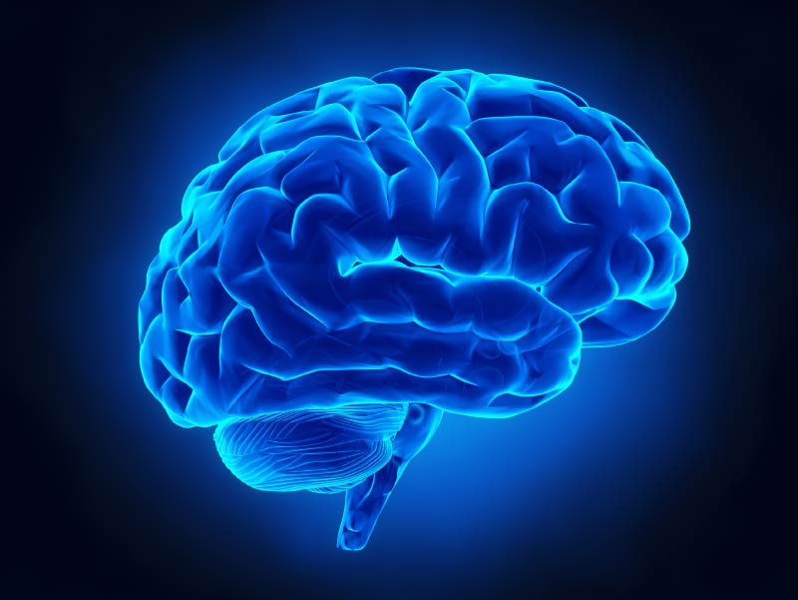
Objectives
Gather and Perform
Gather, create and perform pre-processing on the dataset (Hamada, 2020).
Develop, Evaluate and Compare
Build and evaluate the final CNN and VGG16 model based on their learning curves, and on the evaluation metrics, and compare each other.
Develop the front-end of the website using Bootstrap and the back-end with flask and Python.
Build the web application

Slide 6
Relevance
Business Case
This project applies deep learning techniques to classify images.
The use of deep learning models is related to the second part of the Data Analytics and Machine Learning Module.
Knowledge acquired from the Data Science Product Development Module is also implemented for the final data product.
Healthcare is a very important domain and higher accuracies need to be achieved.
The final data product developed in this project can be used by less experienced doctors for faster and more accurate brain tumor detection.
It can also be employed as a second opinion in their initial screening.

Slide 7
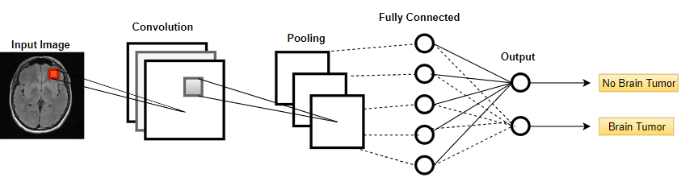
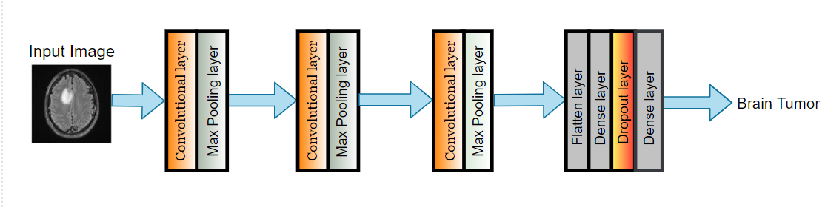
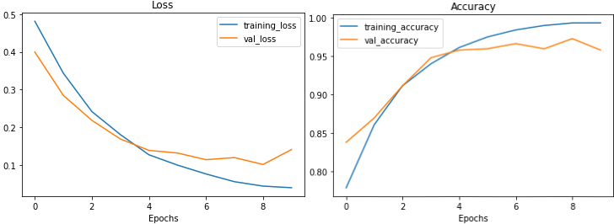
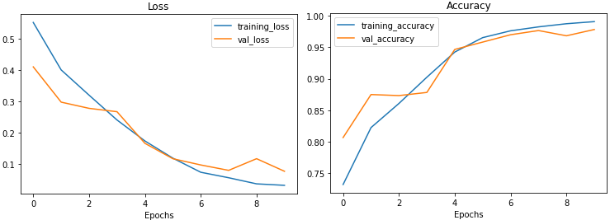
Convolutional Neural Networks
Baseline Model
Final Model
The model is overfitting the training data for three main reasons:
Validation loss starts increasing at the end of the training.
Validation accuracy decreases at the end of the training phase.
There is a big gap between validation and accuracy loss.
The final CNN model performs very well based on its learning curves because:
The curves follow each other.
The gap between the loss curves is minimized.

Slide 8
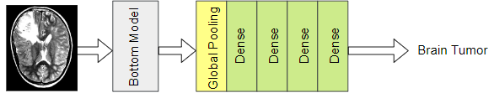
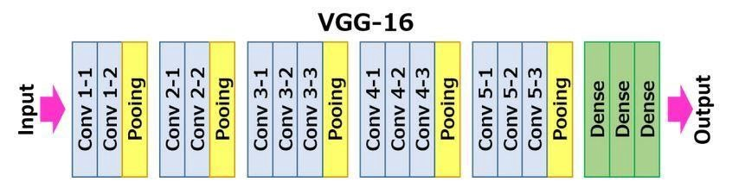
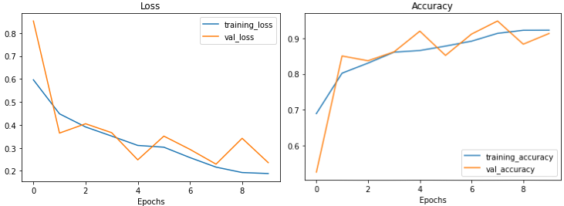
VGG16 with Transfer Learning
Transfer Learning: the general idea behind transfer learning is to take the learning patterns and knowledge of a deep learning model and use them for a related task.
Architecture of the VGG16 model
Architecture of the final VGG16 model
Bottom Model
Knowledge
Learning Curves:
The VGG16 model performs well even though the validation loss is little spiky.
The validation curve is above the accuracy curve in both plots at the end of the training.
The gap between the loss curves is small.

Slide 9
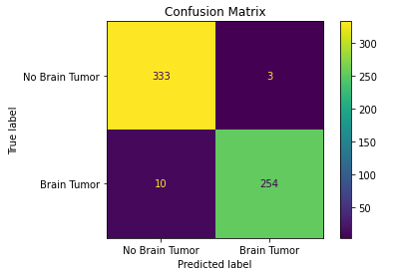
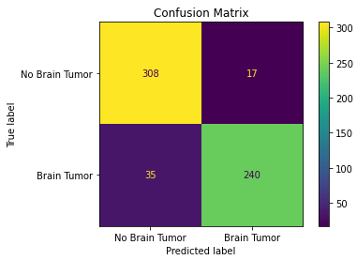
Results Comparison of the Final CNN Model and VGG16 Model
The final CNN model outperforms the VGG16 model based on the standard evaluation metrics.
Loss and accuracy plots of the model designed from the scratch showed better performance during the training and testing phase.
Final CNN model
VGG16 model
The final CCN model misclassified 13 brain MRI images out of 600.
The VGG16 model misclassified 52 brain MRI images out of 600.

Slide 10
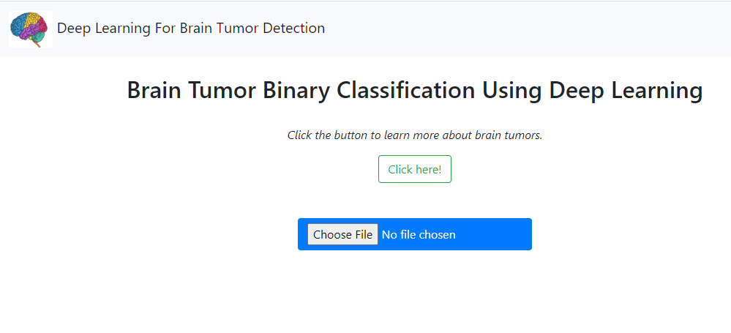
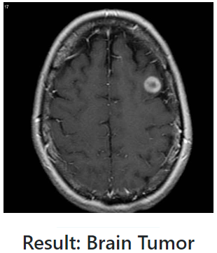
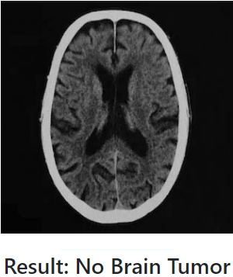
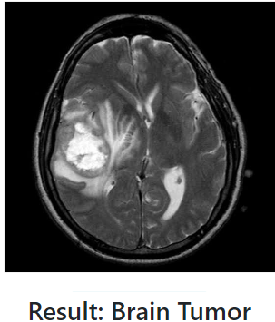
Web Application
Predictions

Slide 11
Ethic Considerations and Further Research
The rapid advancement of AI systems has led to many issues which must often be examined to ensure that they are not used in a way that harm any individual (Gerke et al., 2020).
An ethical consideration that should be taken into account for this project is the source that the dataset is extracted from.
Since the dataset is publicly available on Kaggle, there is no concern about data privacy issues.
Bias can creep in if the models are not trained efficiently or in inadequate data.
This can affect the decisions made by the clinical experts and thus, the health of the patients.
Improve the accuracy of the models by trying different image pre-processing steps or change their architecture.
Evolve from the binary classification task into a multi-class classification task.
Perform image segmentation.

Slide 12

References
Irmak, E. (2021) ‘Multi-Classification of Brain Tumor MRI Images Using Deep Convolutional Neural Network with Fully Optimized Framework’, Iranian Journal of Science and Technology - Transactions of Electrical Engineering, 45(3), pp. 1015–1036. Available at: https://doi.org/10.1007/s40998-021-00426-9.
Gerke, S., Minssen, T. and Cohen, G. (2020) ‘Ethical and legal challenges of artificial intelligence-driven healthcare’, in Artificial Intelligence in Healthcare. Elsevier, pp. 295–336. Available at: https://doi.org/10.1016/B978-0-12-818438-7.00012-5
Kang, J., Ullah, Z. and Gwak, J. (2021) ‘Mri-based brain tumor classification using ensemble of deep features and machine learning classifiers’, Sensors, 21(6), pp. 1–21. Available at: https://doi.org/10.3390/s21062222.
Swati, Z.N.K., Zhao, Q., Kabir, M., Ali, F., Ali, Z., Ahmed, S. and Lu, J. (2019) ‘Brain tumor classification for MR images using transfer learning and fine-tuning’, Computerized Medical Imaging and Graphics, 75, pp. 34–46. Available at: https://doi.org/10.1016/j.compmedimag.2019.05.001.
Hamada, A., 2020. Kaggle. [Online] Available at: https://www.kaggle.com/datasets/ahmedhamada0/brain-tumor-detection

